Slide 1
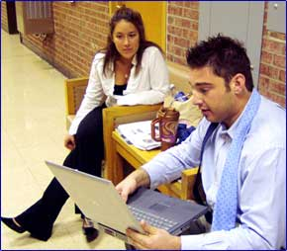
Making a PowerPoint Presentation

Slide 2
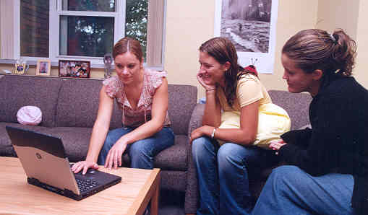
The most important thing to remember about developing a group PowerPoint is that you need to work together as a group:

Slide 3

Designate a “host” computer for your presentation. The person who controls this computer has a responsibility to backup each version to disk.

Slide 4
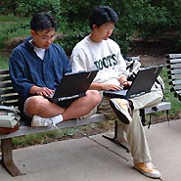
Exchange emails and decide on times and a place to meet outside of class to work outside of class on the final assembly.

Slide 5
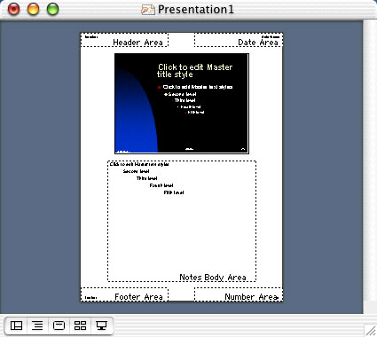
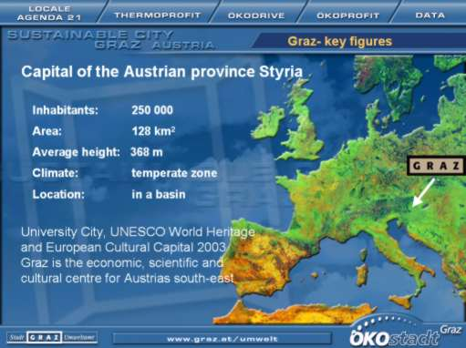
The finished presentation must have at least two slides per group member with accompanying lecture notes. Each group member should be actively involved in the design and writing of at least two slides. This includes lecture notes.

Slide 6
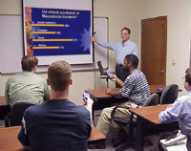
One person can present your effort. All of you should practice reading the presentation aloud. I will decide at the last minute who presents!

Slide 7
As you are researching your individual papers, save pictures and charts which might be useful for you presentation.
Save all the URLs where you found the information. You must include these URLs on the last slide of the presentation. It does not have to be shown, but I will check it.
A sample format would include the slide number of the presentation, the URL, and the date accessed.
Ex. Slide Number 7, www.optiontechnologies.com
Accessed 2/25/06

Slide 8
In group meetings in class, use a sheet of paper for each planned slide to mock up your presentation. Collectively decide on a font (or fonts), font color(s), font size(s), and background color(s) to tie your presentation together.
Example: Lucinda Sans Unicode, 24 point, Font color: dark green (Red 0, Green 51, Blue 0), Background color: light green (Red 153, Green 255, Blue 102)

Slide 9
Basically, all presentations should follow this structure:
Attention-getting opener
Brief overview of the topic
Describe what your audience needs, that is, the problem
Explain how your solution meets that need
Tell how your audience can implement your solution - that is, action steps
Brief summary and conclusion
(From Designing an Influential Presentation by Ellen Finkelstein at Presentation-Points.com)

Slide 10

For this class you need to consider:
1. What are the key problems or expressions of your group topic as seen in your individual countries?
2. What is the action you are proposing?
3. Who is involved? Who or what is the agent of change?
4. Who would oppose the action?
5. How will it be funded? (Consider seed money and continued support)
6. What is the time frame for change?
7. How can you monitor the action to be sure the changes stay on track?

Slide 11

Hints
By Jennifer Anderson
Notes:
Include your names and a topic title on the first slide.

Slide 12

Proof-read and present a perfessional product.

Slide 13

Use appropriate visuals which add information but don’t let them overwhelm the message.

Slide 14
Use colors and dimension to enhance interest.

Slide 15
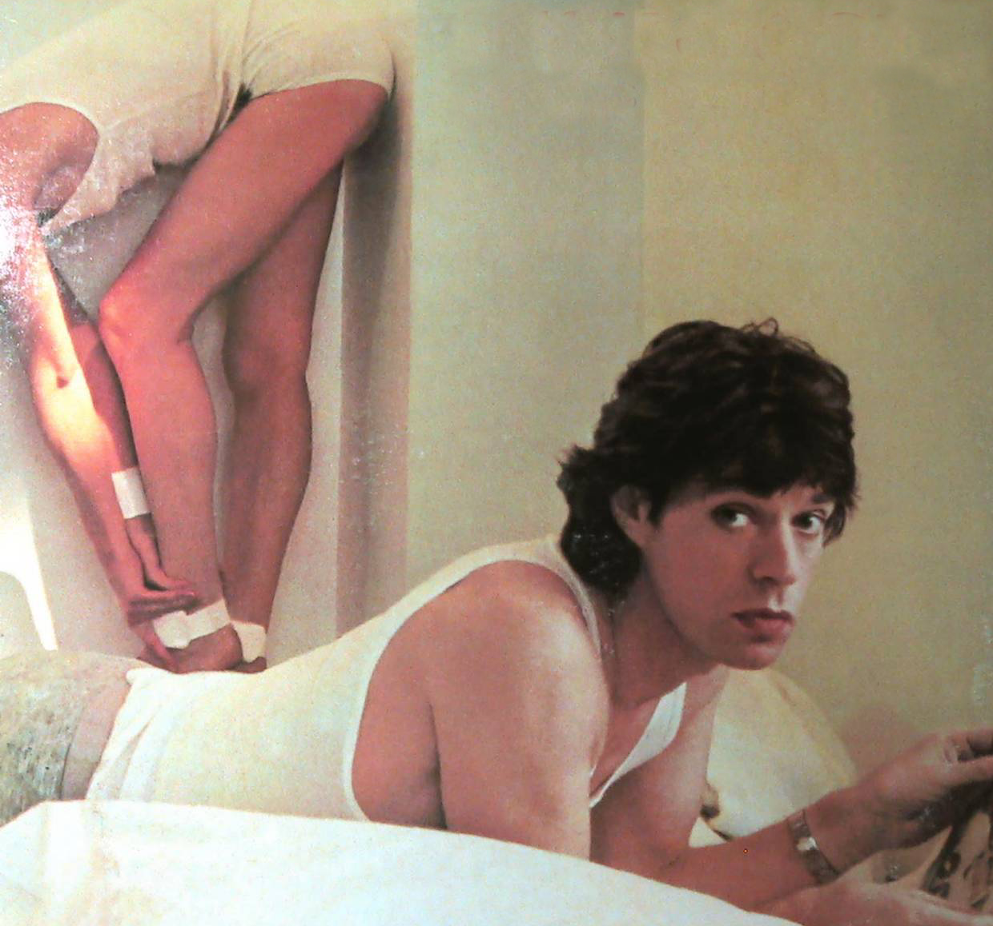
Eliminate distracting backgrounds, avoid centering, and use appropriate typefaces

Slide 16

Make sure your elements appear dynamically balanced.

Slide 17

Avoid:
Abbreviations:
ABC=Australian Broadcasting Corporation, Alcoholic Beverage Control, American Bird Conservancy, Alcoholic Beverage Control
Acronyms
“Today we find that the EU is establishing itself as an actor in the field of WMD”
Jargon
We are producing more because we out sourced"
Let’s not just put a band aid on the problem.

Slide 18
You will be assessed on whether...
The issues were appropriately developed,
points of view from the different cultures reflected cultural sensitivity,
and if you communicated clearly what was important globally and in each culture.

Slide 19

The policy/plan suggestions must be:
1) concrete performable actions rather than vague goals,
2) culturally sensitive (would be acceptable to diverse cultures),
3) taking political realities into account,
4) financially feasible.

Slide 20

Your presentation will be judged for:
organization,
research quality,
presentation,
and impact.

Slide 21

Examples of "death by PowerPoint" (From MicroSoft PowerPoint in Wikipedia, the free encyclopedia) include:
Unnecessarily long presentations
A presenter who simply reads off the slides in a monotonous tone — basically reading to the audience what they can read for themselves off the screen

Slide 22
A PowerPoint presentation with plain text and no graphics or animations

Slide 23
a presentation ridiculously heavy with custom animations for every text (including flying, dragging, checkerboxes and droplets)

Slide 24
Pages cluttered with small, unreadable text
Submit your PowerPoint on a clean (no other material) CD. I reserve the right to keep these CD’s and use them in other classes, if they are really great!
Submit your PowerPoint on a clean (no other material) CD. I reserve the right to keep these CD’s and use them in other classes, if they are really great!
Submit your PowerPoint on a clean (no other material) CD. I reserve the right to keep these CD’s and use them in other classes, if they are really great!
Submit your PowerPoint on a clean (no other material) CD. I reserve the right to keep these CD’s and use them in other classes, if they are really great!
Submit your PowerPoint on a clean (no other material) CD. I reserve the right to keep these CD’s and use them in other classes, if they are really great!

